Slide 1
Troubleshooting Nginx

Slide 2
Configuration File Errors
nginx -t nginx: [emerg] unknown directive "servver" in /etc/nginx/conf.d/wisdompetmed.local.conf:1 nginx: configuration file /etc/nginx/nginx.conf test failed

Slide 3
Configuration File Typos
root /var/www/htm1
server_name example.com www.examples.com

Slide 4

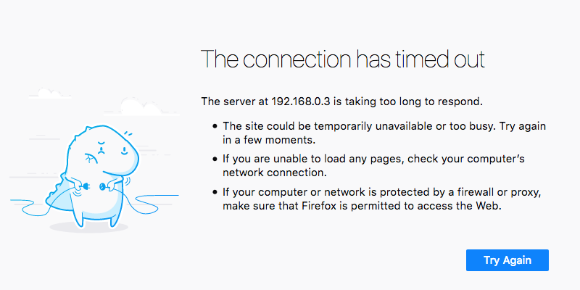
Site Can’t Be Reached

Slide 5
Check Nginx Status and Reload the Configuration
sudo systemctl status nginx * nginx.service - A high performance web server and a reverse proxy server Loaded: loaded (/lib/systemd/system/nginx.service; enabled; vendor preset: enabled) Active: active (running) since Mon 2018-10-11 23:22:22 UTC; 14min ago systemctl reload nginx

Slide 6
Make Sure Nginx is Listening on the Correct Ports
sudo lsof -P -n -i :80 -i :443 | grep LISTEN
sudo netstat -plan | grep nginx

Slide 7
Tail the Logs
tail -f /var/logs/nginx/*.log

Slide 8
Seek Help
Search Engines http://stackoverflow.com

